Slide 1

Project 2: Primary education access indicator – 2018
Maxime Guitton
Paul Melin
Sarah Léouffre

Slide 2
Project description
OUR AIM : Identify the countries that offer the best access to primary education.
Chosen key indicators :
Literacy
Age of first entry at school
Number of compulsory years of school
Rate of primary school access

Slide 3
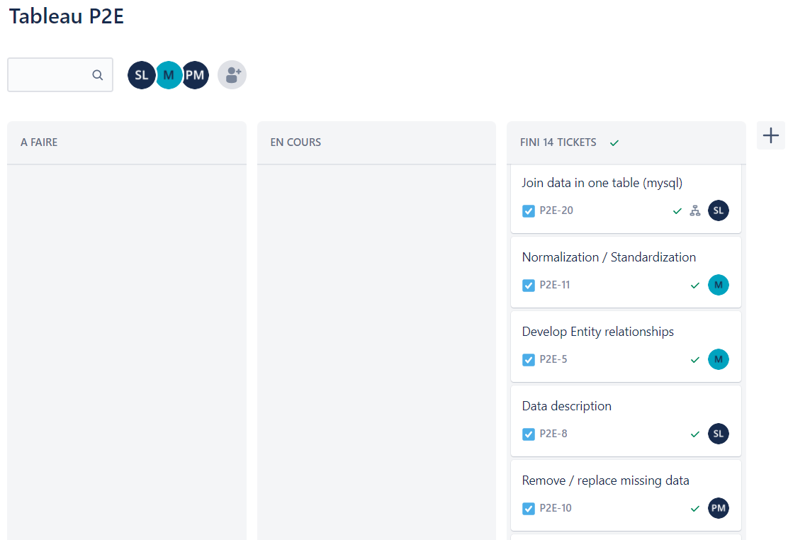
Challenges
Extracting valuable data
Cleaning data properly (missing value vs. Value = 0)
Normalizing data thanks to SQL

Slide 4
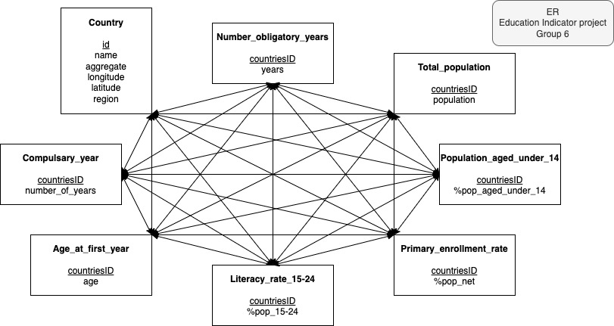
Process
1. Discussing the subject wanted indicator
2. Researching datasource
3. Extracting data on Python thanks to worldbank API
4. Concatenate Data on MySQL , join tables
5. Normalize the data and create the indicators
6. Analyse data, criticise and make conclusions

Slide 5
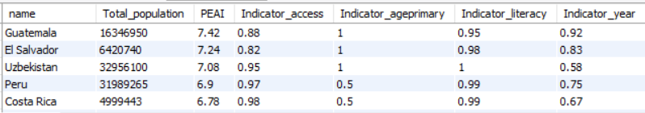
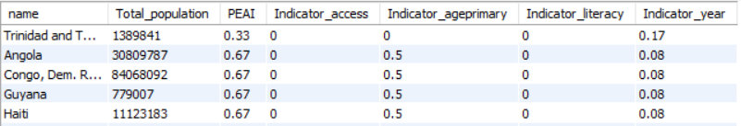
Main results
Results analysis: Surprising countries at first place
Possible reasons:
Several biases
Not enough indicators
Some indicators with value 0 (missing values were cleaned)
Reliable data for some countries ?
Subjective ponderation (weight 1 to 3)

Slide 6

Any questions ?

